Slide 1
March Madness Machine Learning Challenge
Samuel Kellum and Ethan Perello
Mentor: Professor Mattei

Slide 2
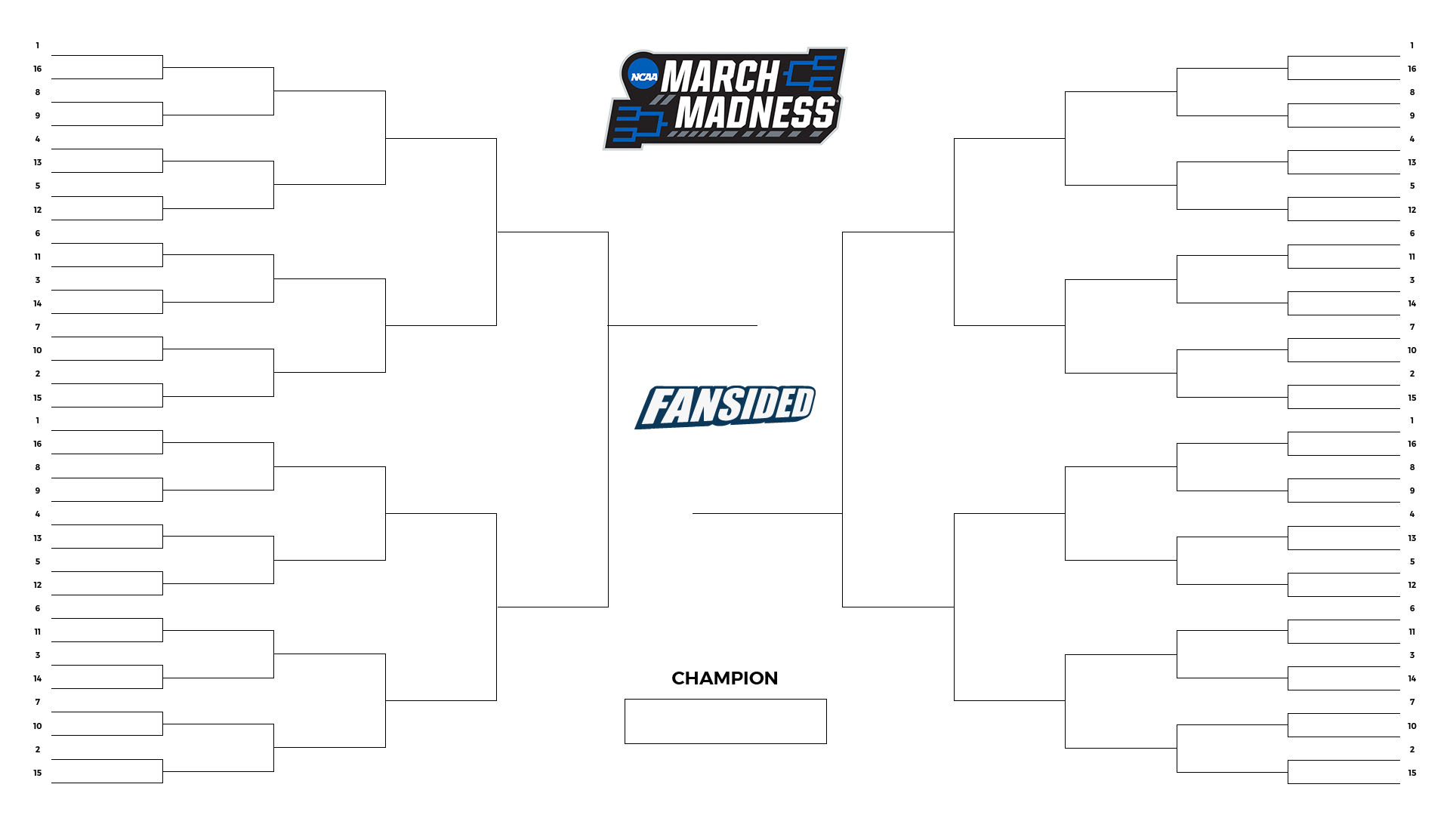
March Madness
March Madness is an annual basketball tournament between 68 seeded teams from Division I NCAA Basketball.
Many people attempt to fill out brackets predicting the winners of each round of the tournament.

Slide 3
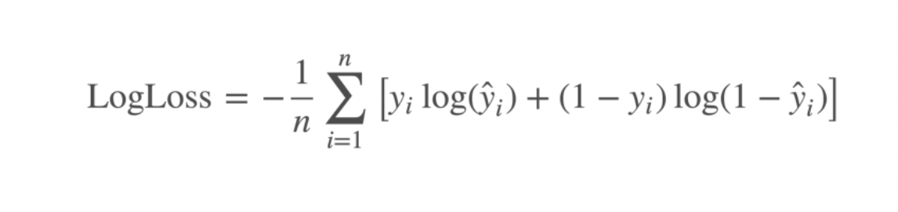
About the Kaggle Competition
The goal of this Kaggle competition is to create a model to predict the winners of college basketball games in the annual March Madness tournament. Millions of people every year attempt to predict the outcomes of these games and people bet billions of dollars on their predictions.
The first phase of the competition is to build the model and test it against previous tournaments and the second phase is to actually try to accurately predict the outcomes of the 2023 March Madness tournament.
Predictions will be analyzed using the log-loss function.

Slide 4
Previous Work
We have access to previous successful submissions
Things we noticed about previous successful submissions:
Besides solely relying on game results, many successful submissions incorporate rankings into their models
Lots of successful submissions are relatively simple (we found one that placed 2nd overall only using LogisticRegression, they just choose the right features for their machine learning model

Slide 5
Proposed Approach
There are four types of machine learning:
Supervised
Semi-supervised
Unsupervised
Reinforcement
Since we know our inputs (features generated from collected data) and desired output (probability of each team winning a game), we know that we will use a supervised machine learning algorithm.

Slide 6
Proposed Approach
One important thing issue we are investigating is whether to use a classification or regression model:
Classification approach:
Compute outcome probabilities by predicting the team that wins
Regression approach:
Compute outcome probabilities by predicting the score gap

Slide 7
Feasibility
Basketball data is very well recorded and we will have access to many public datasets that will be useful to us.
Through Kaggle we have access to all of the previous attempts in previous years of this Kaggle competition. These will be very helpful in creating our model.
The problem is also very well defined. We will be able to easily tell whether our model is effective by testing it against the outcomes of previous March Madness tournaments.

Slide 8
Novelty
We will understand more as we experiment with and determine the features, but we will be looking at previous submissions to the Kaggle competition to ensure the novelty of our methods.
We have many ideas and will be testing different approaches and seeing how effective they are.
One novel idea that we have in mind is using NCAA game prediction data scraped from the internet as a feature. Many websites record predictions for all NCAA games and we can use this data in our model.

Slide 9
Sophistication
We are competing against machine learning experts because this is a Kaggle competition. Our model must be sophisticated in order to compete and have a chance at winning the competition (which is the ultimate goal.)
We will have to test many supervised machine learning algorithms to decide which model is best to use for the competition.

Slide 10
Work in Progress
First Model: Classification (Logistic Regression) and Regression (Linear Regression) Model Comparison
Backtest results on tournaments since 2016-17
Data used for model: Past tournament seeding data, Past regular season and tournament data, fivethirtyeight ratings data
Features: seed difference, fivethirtyeight ratings difference, win percentage difference, average win margin difference
Classification Model (Average score: 0.566) performed better than Regression Model (Average score: 0.578)

Slide 11
Timeline
First Model: Today
3rd Milestone Report: Nov 18, 2022
2nd and 3rd Models: Dec 1st, 2022
End of Semester Presentation: Dec 2nd, 5th, 7th, 9th or 13th, 2022 4th Milestone Report: Dec 16th, 2022
4th and 5th Models: Feb 15, 2023
6th and 7th Models: Mar 15th, 2023
Submit Model for Competition: Before start of tournament
NCAA Basketball Tournament: Mar 14, 2023 – Apr 3, 2023
SSE Expo: April 14, 2023

